Slide 1




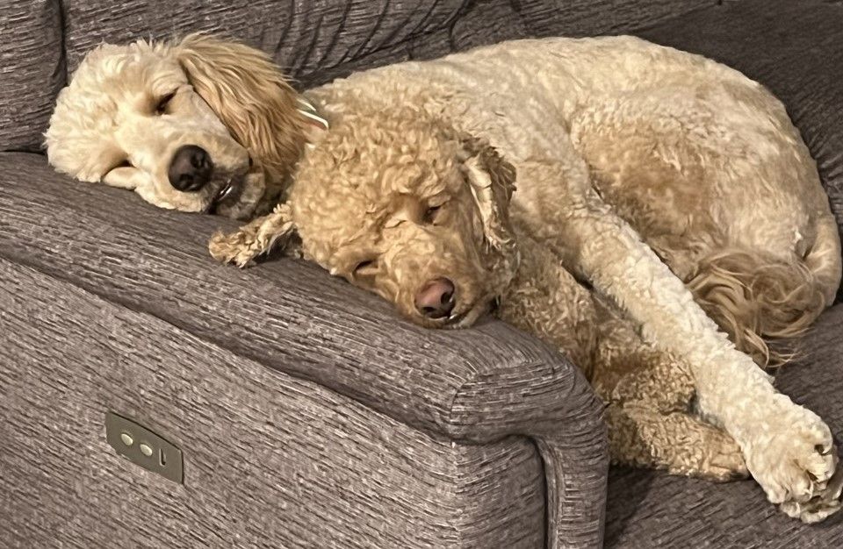
The Pet MATCHER
https://github.com/madisonwikoff/CSC102Project.git
Madison Wikoff, Najja Price, Devin Mason
A program that will match you to a pet that best fits your needs by analyzing your current lifestyle. The first phase involves the user answering quiz questions on a user interface, which will lead the machine to its conclusion of which kind of pet would fit you best.
Once the match has been made, the program will help the user compare essential items such as food, equipment, toys, and more, and will show details such as ingredients and cost to compare at the user’s request.
Lastly the program will help the user design a routine for the new family addition, such as when and how much to feed the pet, when to play with the pet, and more. In this part of the program, we hope to incorporate GPIO, utilizing different colored LEDs as signals that will blink to signify that it’s time for a certain activity with the pet. For example, a blinking blue LED will be the signal that it’s time to feed the pet.

